Slide 1

A Two-dimensional Depth-Averaged Numerical Modeling for Urban Flood with Adaptive Mesh Refinement Method
Wentao Gong
Supervisor: Toshiki Iwasaki and Yasuyuki Shimizu
Water Disaster and Environmental Research Laboratory
Sapporo, Japan

Slide 2
Content
Background
Previous work
Objective and Purpose
Target city and Elevation model
Computational model
Boundary conditions
Wet/dry boundary tracking
Test case1: Uniform Discharge
Test case2: Non-uniform Discharge
Test case3: Multiple Inflow
Conclusion

Slide 3
Background
Managing urban flood risk is one of the key global challenges of the twenty-first century with future flood risk, owing to climate change , urbanization, reductions in urban green spaces and deteriorating urban water management infrastructure (Lowe,J.A et al.,2018; Speight VL et al.,2015).
However, 2D models present their main drawback of requiring large and sometimes unaffordable computational times when applied to realistic scenarios. (Echeverribar et al.,2019)
One of the solutions: AMR
Adaptive mesh refinement method proposed by Berger and Oliger (1984) can refine and derefine the grid to use high resolution where it is needed or interested, which in return can save the computational cost in some way.

Slide 4
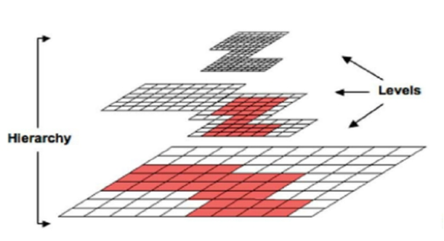
Previous Work
1.PARAMASH
MacNiece et al.(2000,2004) presented a toolkit called PARAMESH.
It is a set of Fortran 90 routines designed to enable Adaptive Mesh Refinement(AMR) for a parallel distributed memory machine.
The developer can develop his own- solver based on the PARAMESH with AMR and parallel computing.
Figure 1. Block-structured AMR grid containing a hierarchy of nested refinement levels. (from MacNeice et al.2000)

Slide 5
Objective
So far, the AMR technique has not been extensively applied to flood modeling yet.
The refinement criteria and strategy should also be investigated further.
The objective in this work is：
To develop two-dimensional depth-averaged numerical modeling for urban floods based on AMR and Finite difference method
Apply this numerical modeling to a case of urban flood in Sapporo, Japan.
To evaluate its accuracy and efficiency based on various refinement criteria by comparing it with the fine grid method.

Slide 6
Target city and elevation model
Figure 2. a) The center of Sapporo city, Japan. b) Modelled elevation data of the objective area (Morikawa (2019)).

Slide 7
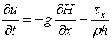
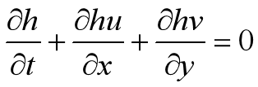
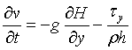
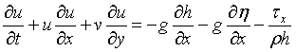
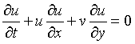
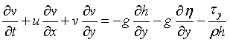
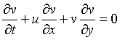
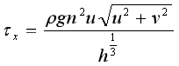
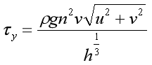
Computational Model: Fractional Step Method
Nonadvection term
1. Governing equations: shallow water equations
(5)
(1)
(6)
(2)
Advection term
(7)
(3)
(8)
(4)

Slide 8
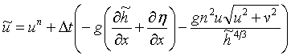
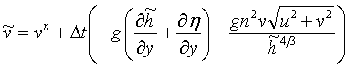
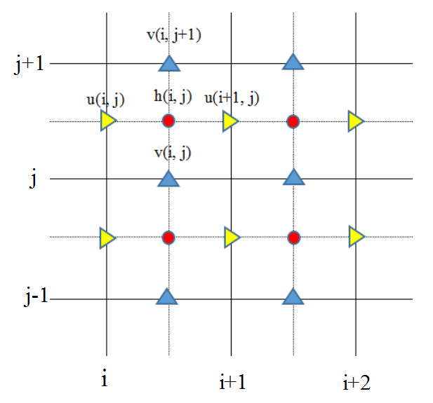
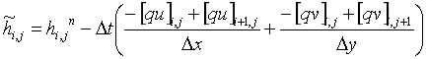
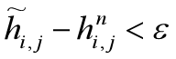
Computational model
Solving the advection term with CIP method
Iteration of Nonadvection term using implicit method
(15)
(9)
(10)
(16)
(11)
(12)
(13)
Figure 3. The location of the h (water depth), u, v (flow velocities in x and y directions) on the staggered grid
(14)

Slide 9
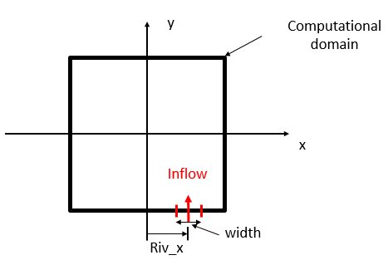
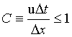
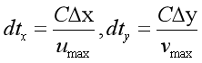
Boundary conditions
Time integration
For each direction, we can calculate the Courant Number as below
Wall boundary
(17）
Wall boundary
Wall boundary
The Courant Number is set 0.2 in this study. As time iteration, we could find the maxim velocity in x, and y direction. Then we could obtain the smallest dt
(18）
dt =min(dtx,dty)
(19）
Along the solid wall, the no-slip boundary condition of v =0
This global minimum time step is to used everywhere, regardless of local refinement level.

Slide 10
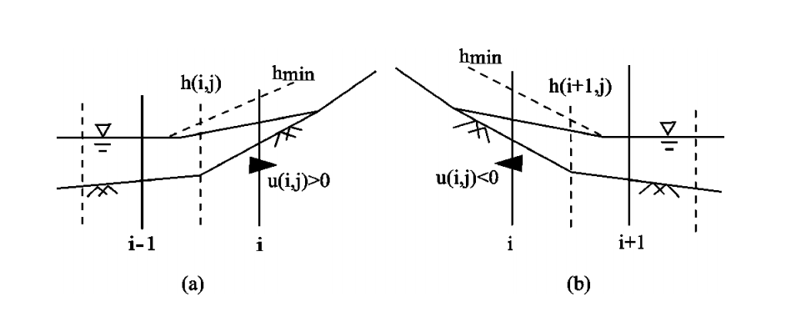
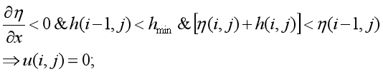
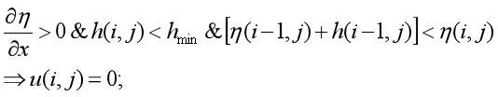
Wet/dry boundary tracking
(20）
(Jang and Shimizu et al.,2005)
(21）
Scheme of boundary near the emerged bars and banks in a staggered grid system:
or in the x or y direction
or in the x or y direction
Since hmin has a very small value, but there is flow velocity in the y or x directions in these situations, the momentum equations are not solved and the flow velocity is set to zero, which probably leads to some numerical error

Slide 11
Since hmin has a very small value, but there is flow velocity in the y or x directions in these situations, the momentum equations are not solved and the flow velocity is set to zero, which probably leads to some numerical error, and must be studied further in the future. In these equations, hmin is set to 0.02 m to minimize the error. In the fully wetted regions, the continuity and momentum equations are solved using the CIP method in the advection terms.

Slide 12
Test Case1: Uniform Discharge (2000s)

Slide 13
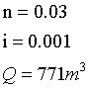
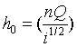
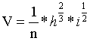
Test case1: Uniform Discharge(2000s)
Table 1. The calculation condition of the computational model.
For the inflow

Slide 14
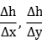
Table 2. Conditions of AMR Cases
Test Cases | Refinement Criteria | Threshold value |  | Refinement level
 |  | upper value (refine) | lower value (derefine) | Min. | Max. | Grid Size Range
AMR1 |  | 0.35 | 0.25 | 4 | 7 | 4.4<dx,dy<35.2
AMR2 |  | 0.24 | 0.09 | 1 | 6 | 8.8m<dx,dy<280
AMR3 |  | 0.35 | 0.25 | 1 | 7 | 4.4m<dx,dy<280m
AMR4 |  | 0.24 | 0.09 | 1 | 7 | 4.4m<dx,dy<280m
AMR5 |  | 0.005 | 0.0005 | 1 | 7 | 4.4m<dx,dy<280m
AMR6 |  | 0.05 | 0.002 | 3 | 7 | 4.4m<dx,dy<70.4m
AMR7 |  | 0.05 | 0.002 | 1 | 7 | 4.4m<dx,dy<280m

Slide 15
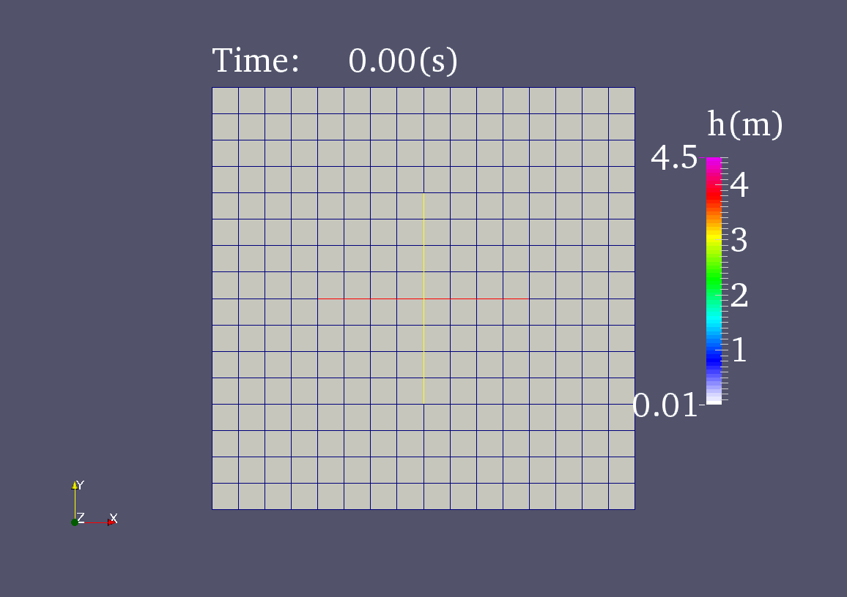
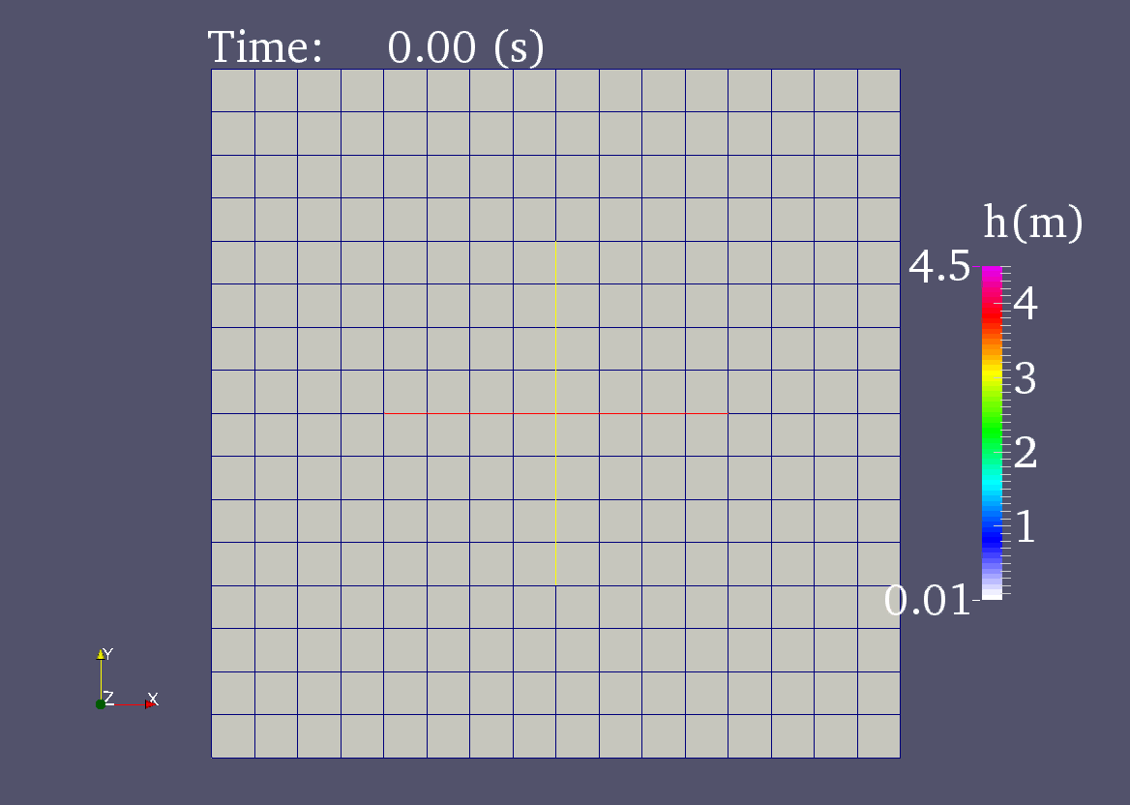
Fine grid case VS AMR case1
Figure 4. The temporal change of water depth left)Fine grid case. right) AMR case1

Slide 16
Figure 6. The water depth along the black line defined in Fig. 1b on the AMR case, fine grid and the coarse gird model, respectively.
Figure 7. Temporal change of the location of the head of flood from the upstream inflow along the black line defined in Fig. 1b.

Slide 17
Table 4. Computational time
Cases | Computational Time | Save time
AMR1 | 3h37min | 66.4%
AMR2 | 39min | 94% Inaccurate
AMR3 | 5h42min | 47% Inaccurate
AMR4 | 3h39min | 66.0% Inaccurate
AMR5 | 3h25min | 68.2%
AMR6 | 3h36min | 66.5%
AMR7 | 3h37min | 66.4%
Fine Grid | 10h45min | 0%
Figure 8. The water depths along the black line (showed in Fig. 1b) at 2000s on various refinement criteria and the fine grid case.

Slide 18
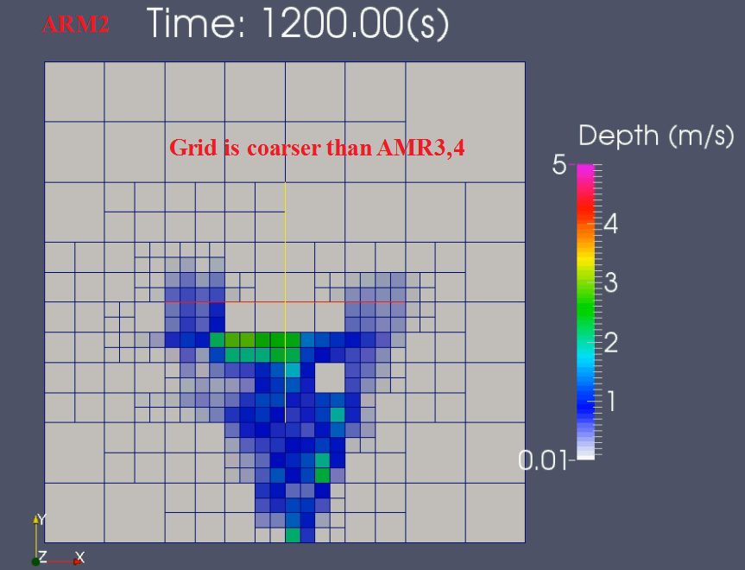
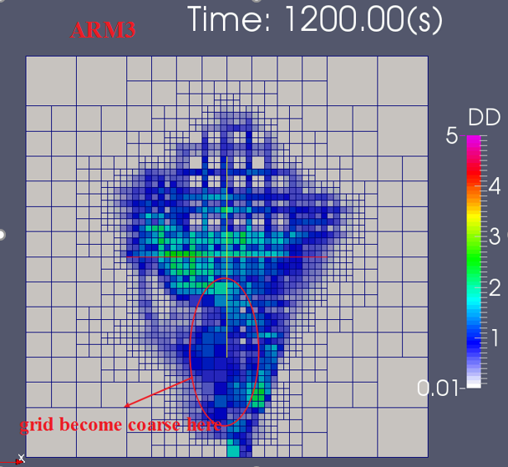
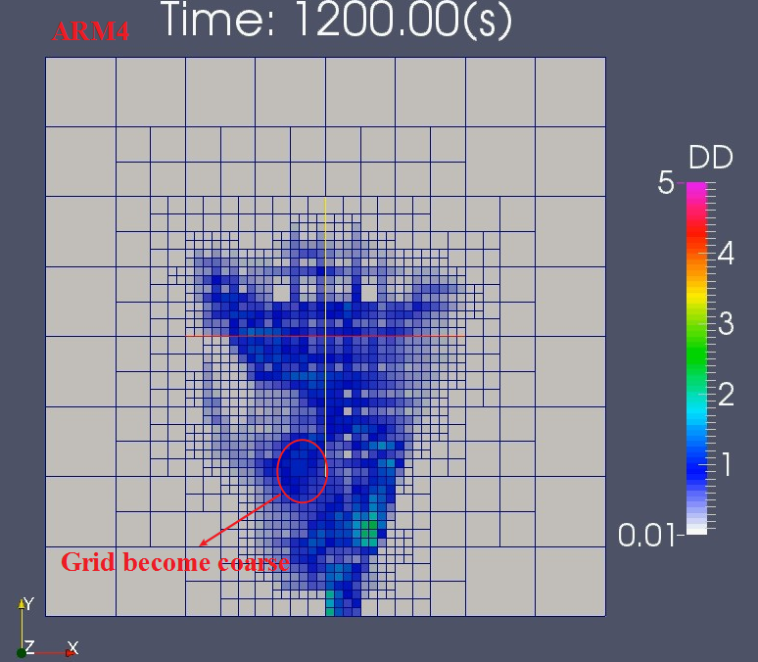
From the Fig 8. we found the water depth of AMR1,5,6,7 cases are almost identical with fine grid case
Figure 9. The mesh refinement of AMR2,3,4 at 1200s
Although AMR2, 3 and 4 is not so accurate compared with Fine grid from Figure 8, the results could become more accurate by revising the refinement level and threshold value for refinement and derefinement.

Slide 19
Figure 10. the velocity along the balck line at 2000s

Slide 20
Test case2:Nonuniform Discharge(6000s)

Slide 21
Test case2:Nonuniform discharge(6000s)
Figure 9. The Discharge change along the time

Slide 22
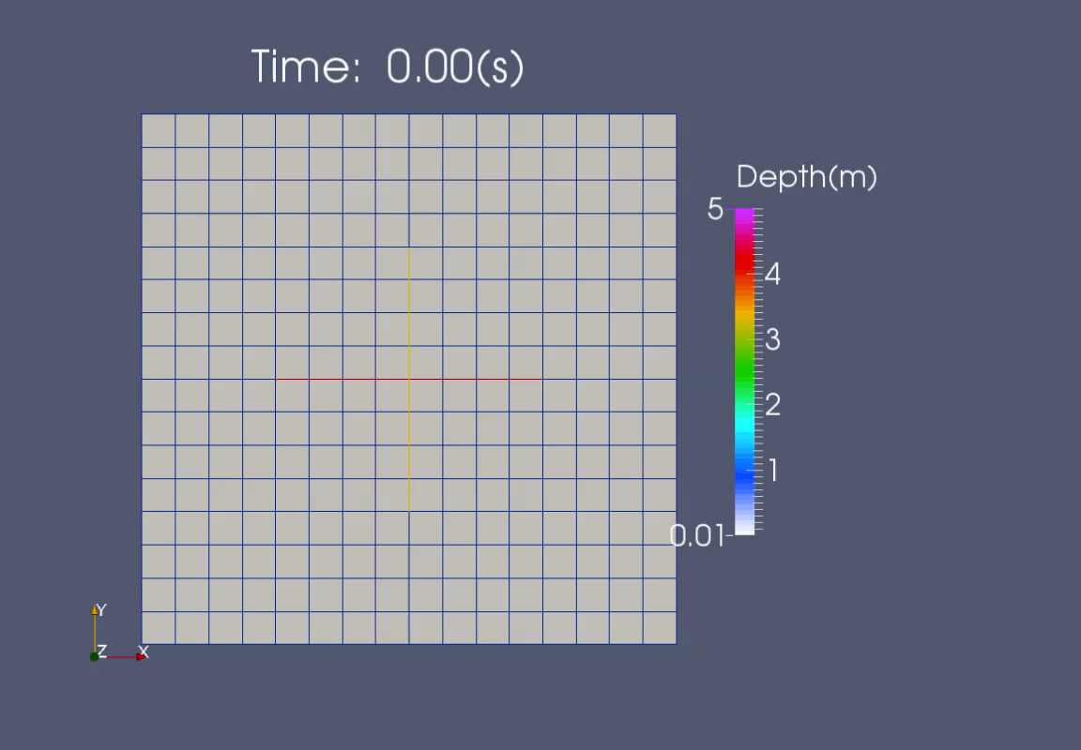
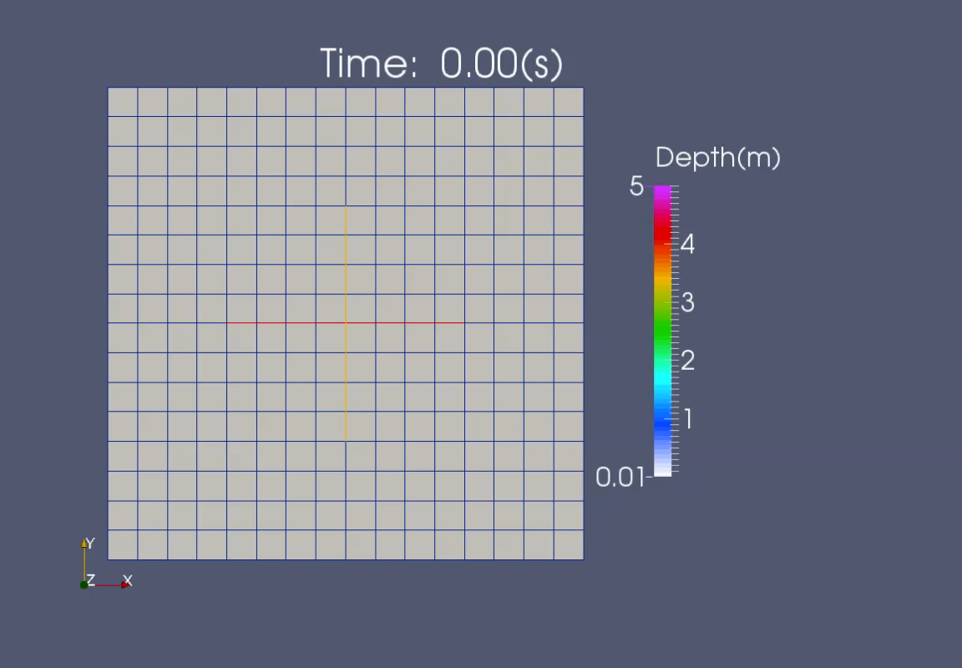
Test case2:saved 43% time !
Computational Time:35h40min
Computational time: 20h4min
Figure 10. The temporal change of water depth left)Fine grid case.
right) AMR case (refinement creteria is same with ARM5

Slide 23
Figure 12. The water depths along the black line (showed in Fig. 1b) at 6000s bewteen AMR5 and the fine grid case on non-uniform discharge case.
Figure 11. The block numbers of AMR case at different time case on non-uniform discharge case.

Slide 24
Test Case3:Multiple Inflow

Slide 25
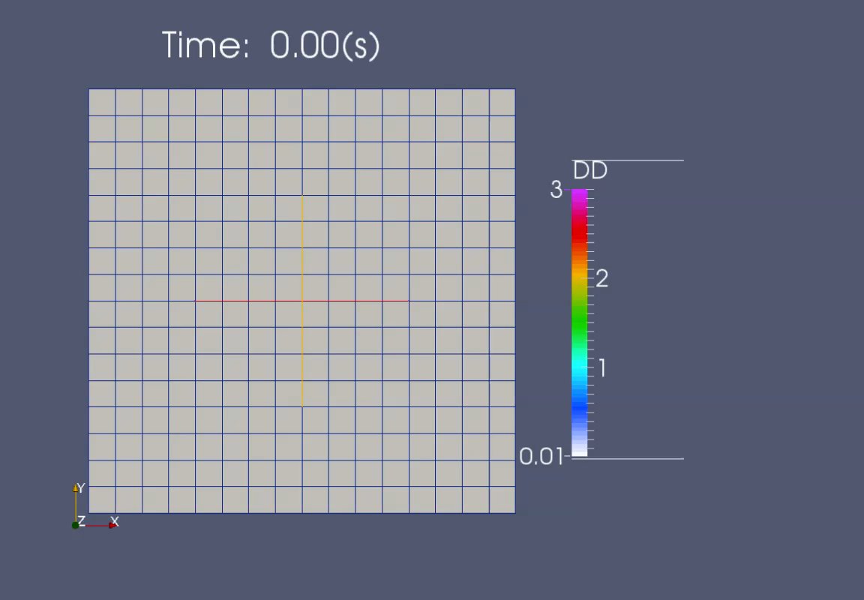
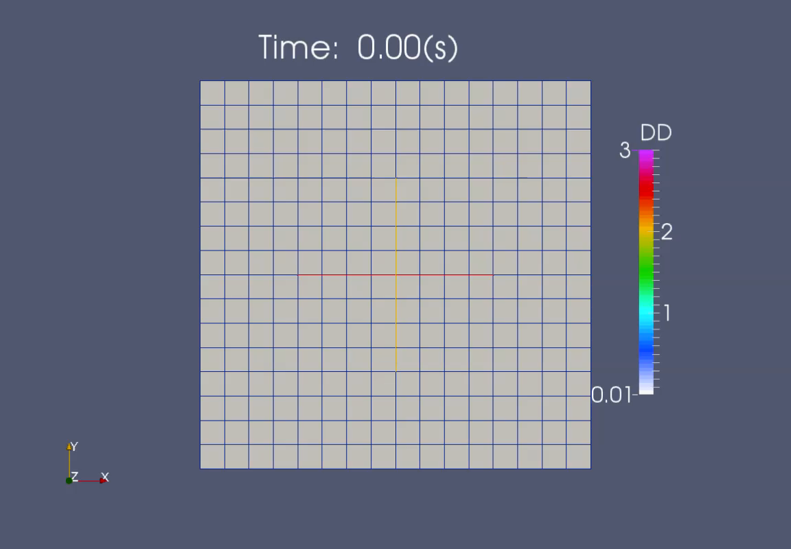
Method | Computational Time
AMR | 2h25min
Fine | 10h43min

Slide 26
Conclusions
To solve the shallow water equations, the fractional step was used. For the Nonadvection term, the implicit method is used for numerical stability and accuracy for unsteady fluid flows. For the advection term, the CIP method was used to prevent the numerical diffusion and keep it accuracy in grid cell.
For the uniform discharge, AMR can save 66.0%-68.2% computational time without significant loss of computational accuracy. The accuracy and efficiency differ compared with Fine grid case, depending on the refinement criteria, refinement levels, and the threshold values. The best refinement criteria is water surface slope in this case.
In the nonuniform discharge case, the water surface slope still can capture the flow characteristics well and saved 43% time.
In the multiple inflow case, the model with AMR saves 77.4% time without loss of accuracy compared with fine grid case

Slide 27
Reference
Berger,M.J., Colella, P. (1989). Local adaptive mesh refinement for shock hydrodynamics. J. Comput. Phys. 82,64–84. doi:10.1016/0021-9991(89)90035-1
Berger,M.J., Oliger, J. (1984). Adaptive mesh refinement for hyperbolic partial differential equations. J. Comput. Phys. 53(3), 484–512. doi:10.1016/0021-9991(84)90073-1415– 427.
Echeverribar, I., Morales-Hernández, M., Brufau, P., & García-Navarro, P. (2019). 2D numerical simulation of unsteady flows for large scale floods prediction in real time. Advances in Water Resources, 134, 103444.
Liu, Y., and Pender, G. (2010). A new rapid flood inundation model. In proceedings of the first IAHR European Congress,4-6.
Bates, P. D., Horritt, M. S., and Fewtrell, T. J. (2010). A simple inertial formulation of the shallow water equations for efficient two-dimensional flood inundation modelling. Journal of Hydrology, 387(1-2), 33-45.
Hankin, B., Waller, S., Astle, G., and Kellagher, R. (2008). Mapping space for water: screening for urban flash flooding. Journal of Flood Risk Management, 1(1), 13-22.
Jang, C.L. and Shimizu, Y. (2005). Numerical simulation of relatively wide, shallow channels with erodible banks. Journal of Hydraulic Engineering, 131(7), 565-575.
Neal, J. C., Fewtrell, T. J., Bates, P. D., and Wright, N. G. (2010). A comparison of three parallelization methods for 2D flood inundation models. Environmental Modelling & Software, 25(4), 398-411.
Morikawa, G. (2019). Numerical analysis of flood with hyper grid model, dissertation for Master degree of Hokkaido University, Sapporo, Japan.
Morikawa, G., and Kimura, I. (2018). Numerical analysis of flood with a double grid model. In E3S Web of Conferences (Vol. 40, p. 05042). EDP Sciences.
Huang, W., Cao, Z., Pender, G., Liu, Q., and Carling, P. (2015). Coupled flood and sediment transport modelling with adaptive mesh refinement. Science China Technological Sciences, 58(8), 1425-1438.
Ali, M. A., Kimura, I., and Shimizu, Y. (2016). Flood modelling using sub‐grid based finite volume approach & constrained interpolation profile method. In Proceedings of the International Conference on Fluvial Hydraulics (River Flow 2016) (pp. 1891-1895). Iowa City, USA: CRC Press.
MacNeice, P., Olson, K.M., Mobarry, C., Fainchtein, R. and Packer, C. (2000). PARAMESH: A parallel Adaptie Mesh Refinement Community Toolkit. Computer Physics Communications, 126(3), 330-354.
Miura, S., Kawamura, I., Kimura, I., and Miura, A. (2011). Study on inundation flow analysis method in densely populated urban area on alluvial fan. Journal of Japan Society of Civil Engineers, Ser. B1 (Hydraulic Engineering), 67.
Cobby, D. M., Mason, D. C., and Davenport, I. J. (2001). Image processing of airborne scanning laser altimetry data for improved river flood modelling. ISPRS Journal of Photogrammetry and Remote Sensing, 56(2), 121-138.
Wang, J. P., and Liang, Q. (2011). Testing a new adaptive grid based shallow flow model for different types of flood simulations. Journal of Flood Risk Management, 4(2), 96-103.
Chen, A. S., Evans, B., Djordjević, S., and Savić, D. A. (2012). Multi-layered coarse grid modelling in 2D urban flood simulations. Journal of Hydrology, 470, 1-11.

Slide 28
Thank you for your listening

Slide 29
Figure 5.The velocity distribution of a) fine grid case, b) AMR case1 at 2000 seconds.

Slide 30
Table 3. Results
 | Maximum Number of Blocks
Cases
AMR1 | 3149
AMR2 | 741
AMR3 | 3849
AMR4 | 3805
AMR5 | 3069
AMR6 | 3069
AMR7 | 3149
Fine Grid | 5461
Figure 7. The block numbers of AMR cases at different time.

